Slide 1
K8C
Resources and microservices

Slide 2
Product description
The product is a platform for deploying, managing, and scaling machine learning models in production. It offers a secure, flexible environment for automating ML tasks like model versioning, routing, and monitoring. With Kubernetes integration and containerization support, it's designed for developers, ML engineers, and enterprises needing scalable, reliable ML infrastructure.
Team K8C: Tsurkan Daniel; Dandamaev Gadji; Tsaturyan Konstantin; Smolkin Mikhail
Project repo: https://github.com/fanglores/Advanced-Software-Design
This report: https://github.com/fanglores/Advanced-Software-Design /blob/master/Practice%20Tasks/Module2/Task9/task9.pptx

Slide 3
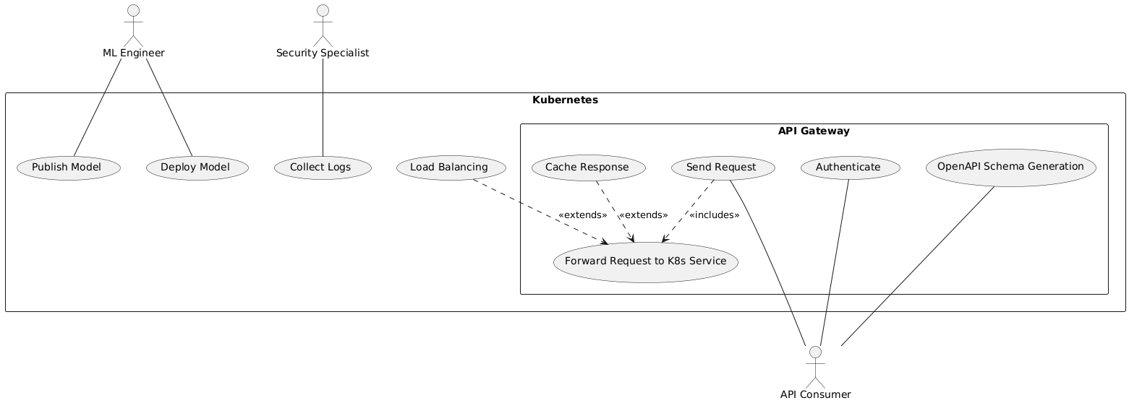
Use case diagram
https://github.com/fanglores/Advanced-Software-Design/tree/master/General/UseCases

Slide 4
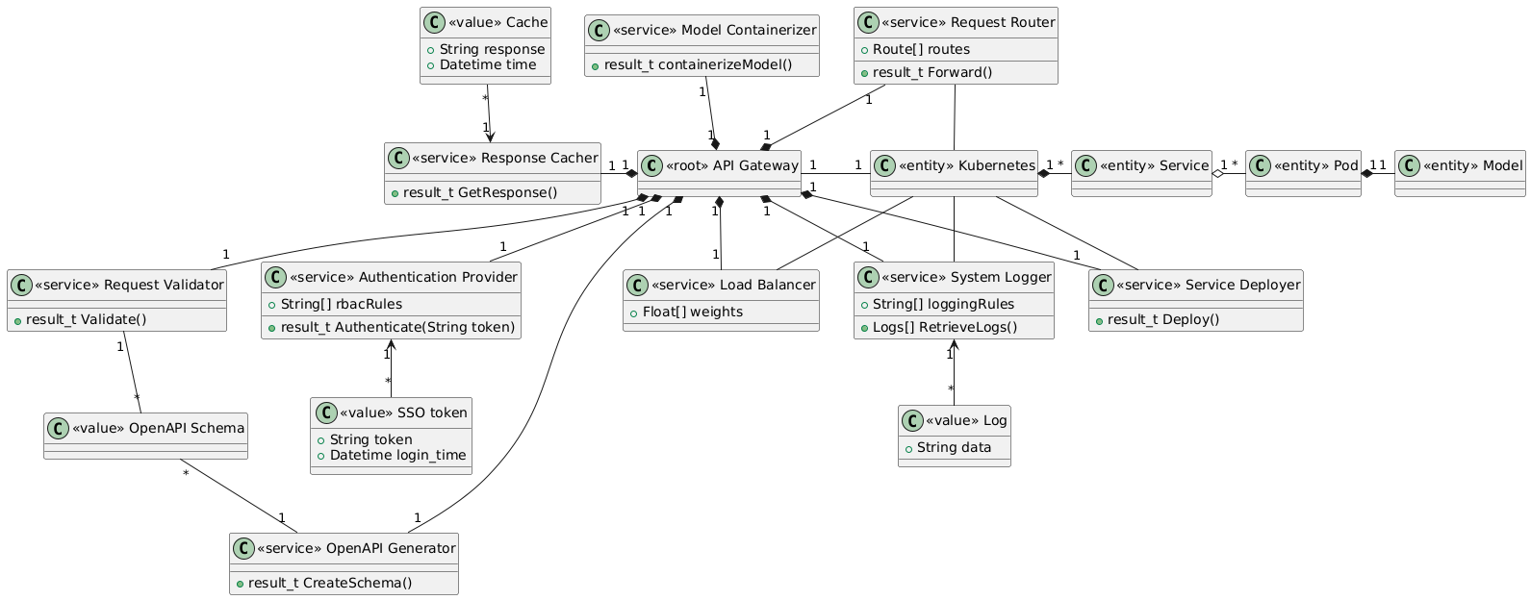
Final class diagram

Slide 5
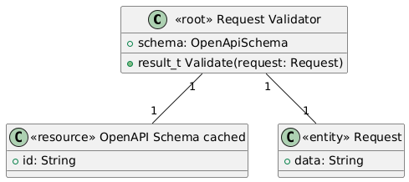
Request Validator Aggregation

Slide 6
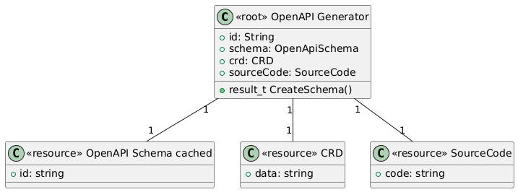
OpenAPI Generator Aggregation

Slide 7
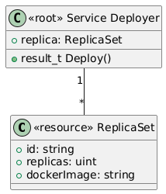
Service Deployer Aggregation

Slide 8
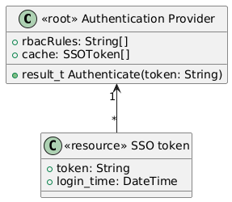
Authentication Provider Aggregation
Decompose into more

Slide 9
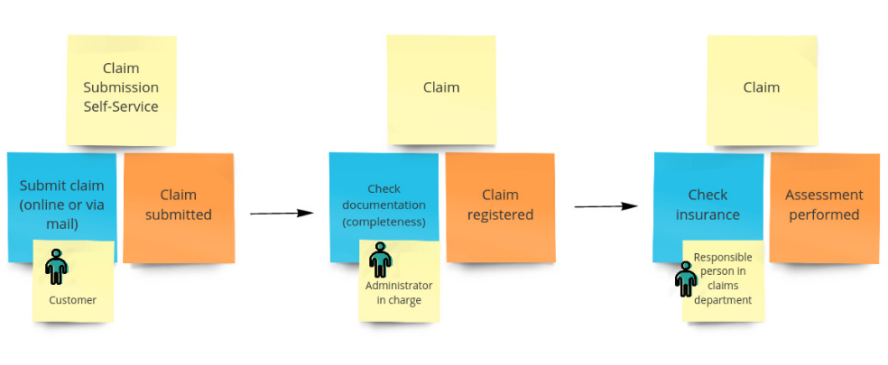
Event storming
Run the event storming session in a team
Check your class diagram and use cases against events and commands in storming.
Add missing events, commands, classes to your domain model
Study how event storming is performed https://en.wikipedia.org/wiki/Event_storming https://contextmapper.org/docs/event-storming/ https://github.com/wwerner/event-storming-cheatsheet

Slide 10
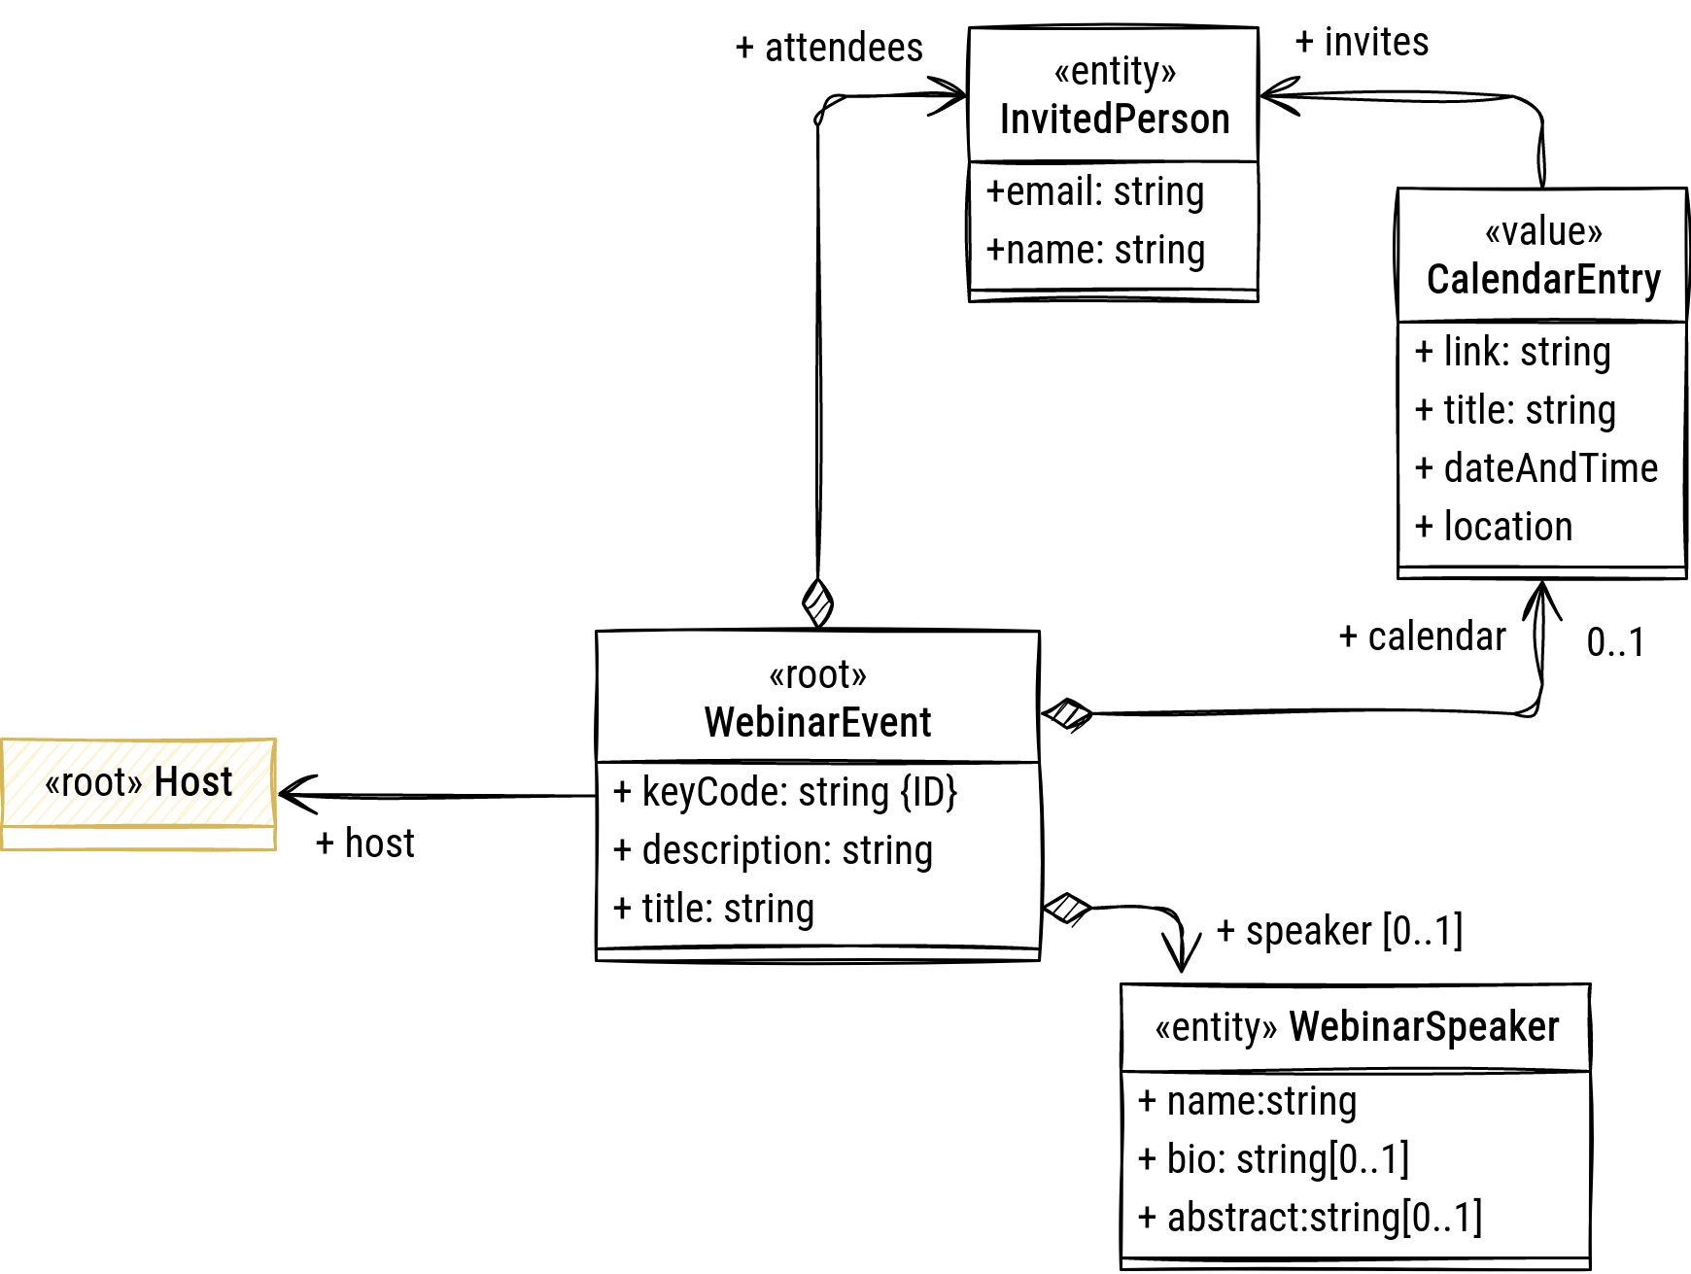
Detailed class diagram - Aggregate WebinarEvent
Show a class diagram for an aggregate
Include new domain events if any found
Check that external references go to roots or domain services only

Slide 11
Detailed class diagram - Aggregate N
Repeat for each aggregate….
Check that external references go to roots or domain services only
Check that commands and events in the storming diagram are elaborated in class diagrams

